Slide 1
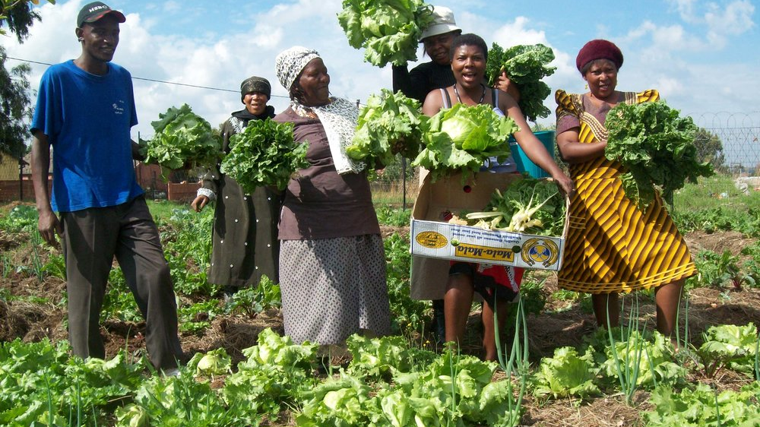
Grocom
The Future of Micro Farm Produce

Slide 2
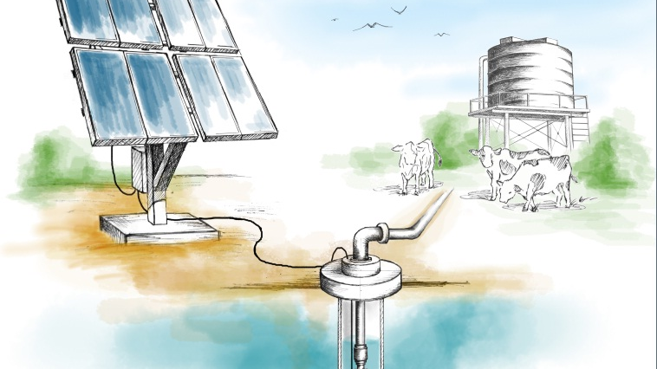
Sustainable Solar Powered Water Management Systems (SPWMS)
Grocom

Slide 3
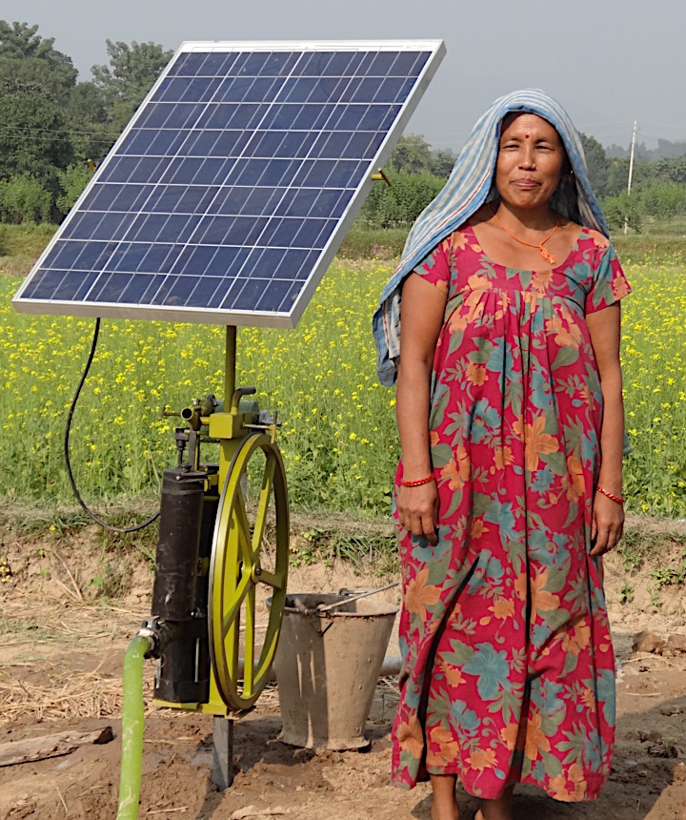

Potential of SPWMS in Sub-Saharan Africa:
Increase farmer yields by 70-300%
Impact 185 million lives
Generate USD 22 billion per year
Source: “Water for wealth and food security”, AG Water Solutions (funded by the Bill and Melinda Gates Foundation)

Slide 4
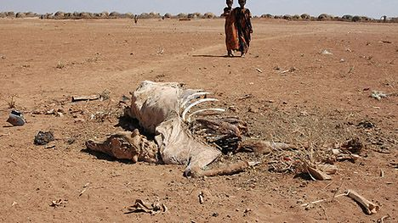
Why hasn’t it happened?
Upfront investment costs
Difficulty accessing information
Difficulty accessing inputs, such as seeds

Slide 5
The Grocom Process
1. Locate farmers who own land close to fresh water
2. Lease and manage SPWM systems
3. Educate farmers to increase yields

Slide 6
The Grocom Process
4. Buy produce directly from micro farmers
5. Sell micro farm produce to the international market
6. Use profit to pay back equipment suppliers

Slide 7





The New Standard of CSR
Carbon Neutral
Certified Organic
Fair Trade
Saving Lives

Slide 8

Fruit with a story…
“Thank you for buying my family’s fruit! We grew this fruit using the sun to power the leaves and to run our water pump. We hope you enjoy it as much as we have!
Please follow my micro farm on Instagram!”
#TiwongesFarm # microFarmProduce

Slide 9

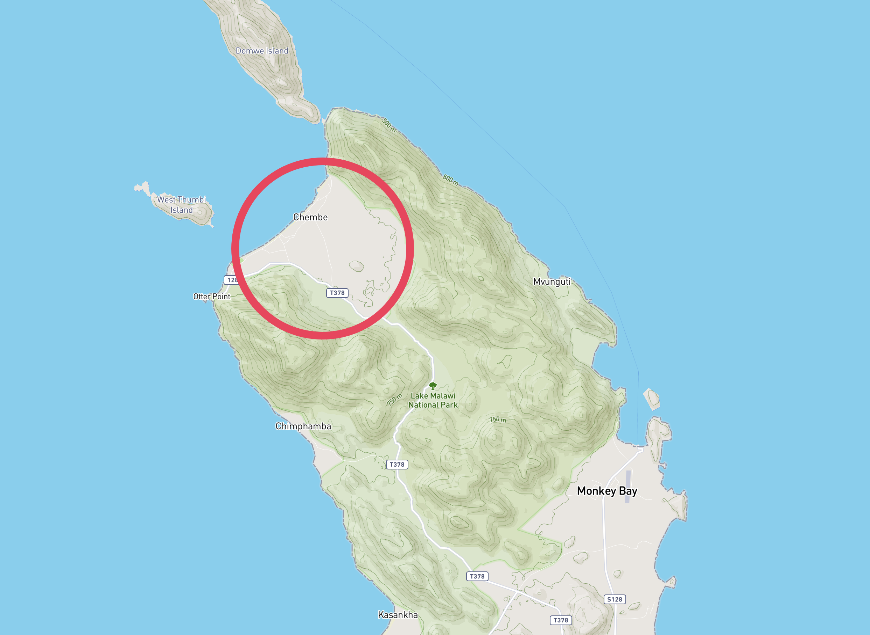
Pilot – Cape Maclear, Lake Malawi, Malawi
In partnership
with:
Currently farmers reliant on growing maize for 3 months to produce enough food for a year
3 hectare site approved for pilot
400 hectare site already offered if successful
Cape Maclear, Malawi
Notes:
Letter –Statement -> Where Text-Box is?
Grocom will work in partnership with Ulimi Irrigation to pilot the first site in Cape Maclear.

Slide 10

“Hi guys,
Super excited to start working together, we have a 3 hectare site ready for irrigation and just need the equipment to make it happen.
We have told the local farmers of your project and they are completely on board.
Good luck with your Hult Prize challenge!”
-Ed
Notes:
Hult Prize
Names
Quote
Ending

